Slide 1
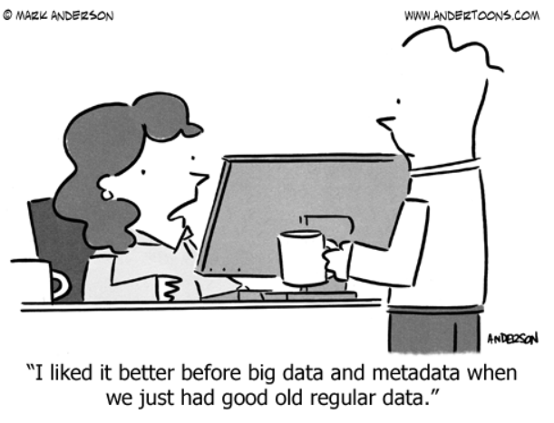
Cultivating a Culture of Digital Preservation Inside Academic Libraries and Out
Kelsey George,
Cataloging and Metadata Strategies Librarian
https://github.com/geokels
Image source: https://www.andertoons.com/data/cartoon/6826/liked-better-before-big-data-metadata-we-had-regular-data

Slide 2
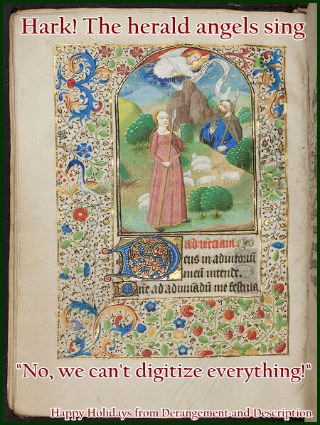
Digitization ≠ access.
Digitization ≠ preservation.
Digitization without a long-term storage and preservation plan is a waste of time and resources.
Image credit: https://derangementanddescription.wordpress.com/2013/12/24/holiday-cards-for-archivists/
Notes:
Digitization is not always equivalent to access. Many obstacles exist when trying to make digitized materials accessible. Digital file formats are susceptible to bit rot, file degradation, file corruption, and generation loss over time. In order for digital objects to be preserved long-term, digital object storage and access to the objects cannot remain static as technologies change.

Slide 3
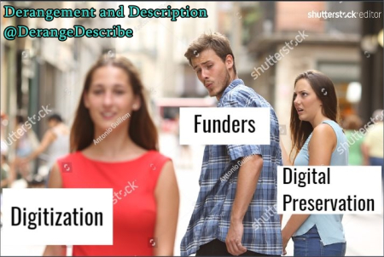
Image source: https://derangementanddescription.files.wordpress.com/2017/08/distracted_boyfriend_digitization.jpg?w=450&h=302
Notes:
In library-land, particularly in American academic libraries, budgets for libraries have been reduced or have stayed the same for years while the newer expense of providing electronic access to journals and other materials has increased. The desire to innovate and stay on top of digital trends is part of the backbone of modern librarianship, but many times the funding does not match the motivation. Often, donors will donate collections or donate funding on the condition that materials be digitized, but donors may not always have an understanding of or desire to fund the infrastructure required to make their collections available online long-term. In addition to digitization costs, other factors to consider include copyright issues; whether materials will be preserved in a separate preservation repository; what level of access will be granted to the collection; development of access, preservation, and descriptive metadata; personnel available; storage space and cost (for both digital and physical materials); and preservation costs (for both digital and physical materials). Libraries without digital preservation policies and infrastructure have the option of accepting donations and then seeking out additional donors/university support, or they have to turn away collections due to a lack of resources. Ideally, libraries should already be connecting with internal (campus) and external (community) stakeholders to get support to preserve collections held in the library, but this isn’t always the case.

Slide 4
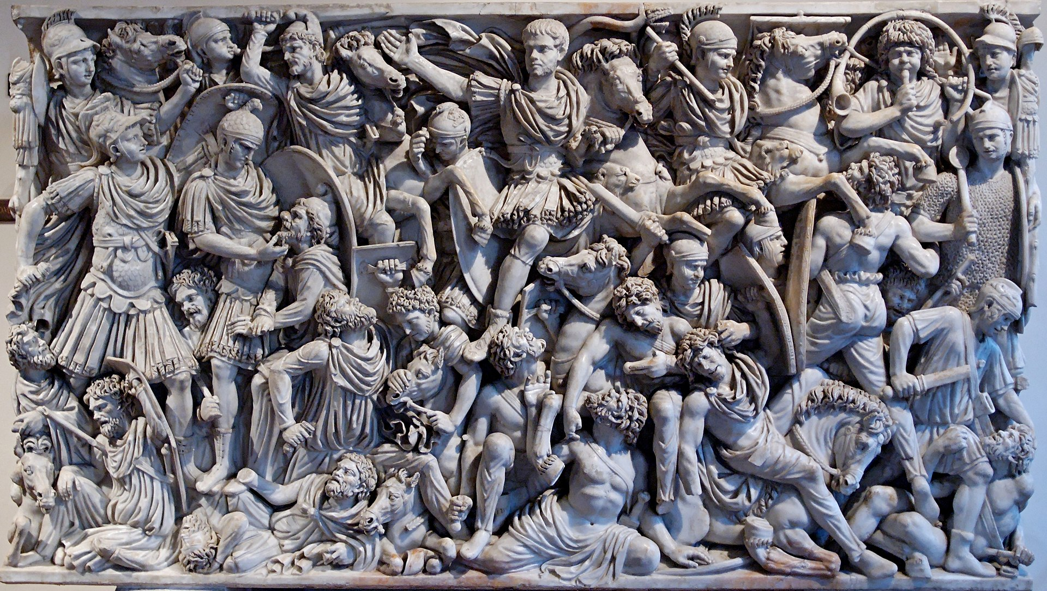
Battle over the Institutional Repository
Image title: Relief panel of the Great Ludovisi sarcophagus
Image source: https://en.wikipedia.org/wiki/Ludovisi_Battle_sarcophagus
Notes:
An institutional repository can sometimes be confused for a digital repository. An institutional repository is an archive for collecting, preserving, and disseminating digital copies of the intellectual output of an institution, particularly a research institution. Digital repositories are mechanisms for managing and storing digital content. Digital repositories are not equivalent to integrated library systems, which are used to index and manage the library’s physical objects and usually also index access points for e-resources and journals. These days, most institutions have some form of digital repository—whether it is for internal use only or is accessible online for external use. Not nearly as many have institutional repositories. Research data need to be housed somewhere. At some institutions, research data live in departmental silos, with storage and preservation supported by campus IT. At others it is currently being handled by the library. Even more often, researchers push for the library to house their data and the library has to refuse the donation, due to the complexity of housing and preserving said data described in the previous slide. This leaves labs and grant-funded projects with no campus support when it comes to meeting data management and publishing requirements for their resources. Libraries are becoming more and more aware of the need for long-term digital preservation and data management infrastructures to be put in place and policies to be established. Some libraries are trying to meet this need by hiring a Digital Preservation Librarian to work on these issues and collaborate across campus. There were only approximately ten librarian jobs with this title posted in the last two years. Other libraries are hiring Digital Collections Librarians or Data Curators, which may perform overlapping functions with regard to digital preservation, but focus more on digital repository needs and campus research data management respectively. If academic libraries do have a digital preservation policy in place, it may be outdated. So what can you do as researchers, students, and faculty to cultivate a culture of digital preservation at your institution?

Slide 5
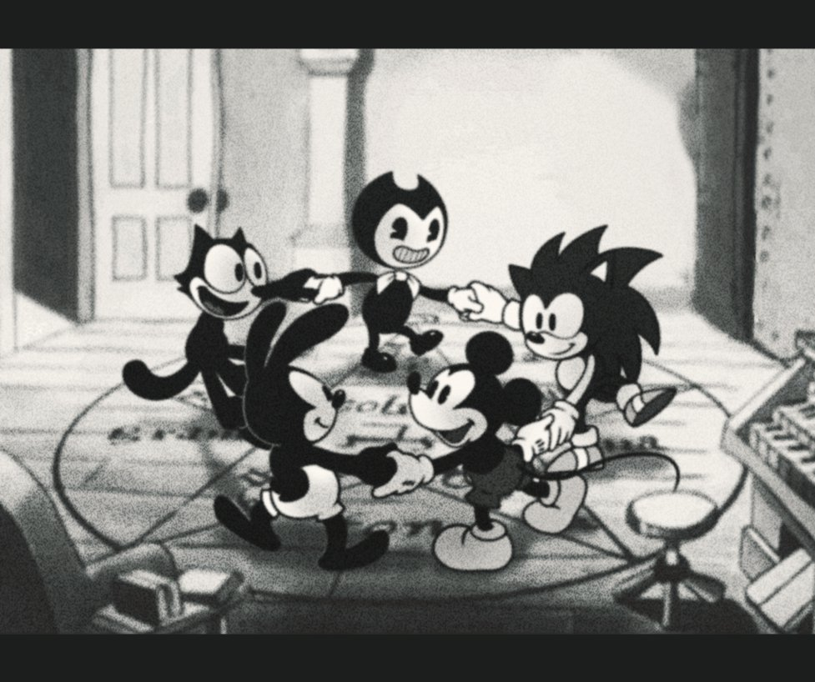
Join or Create a Committee
Notes:
Be part of the conversation. Gather your colleagues, go to the head of digital collections, form a plan, and bring it up the channel. Propose something. Make it campus wide. The library may be unaware, or just may not have the support or funding to make it happen on its own. Adding student, faculty, and researcher voices to the issue and bringing a unified plan to the administration will only help make it happen.

Slide 6
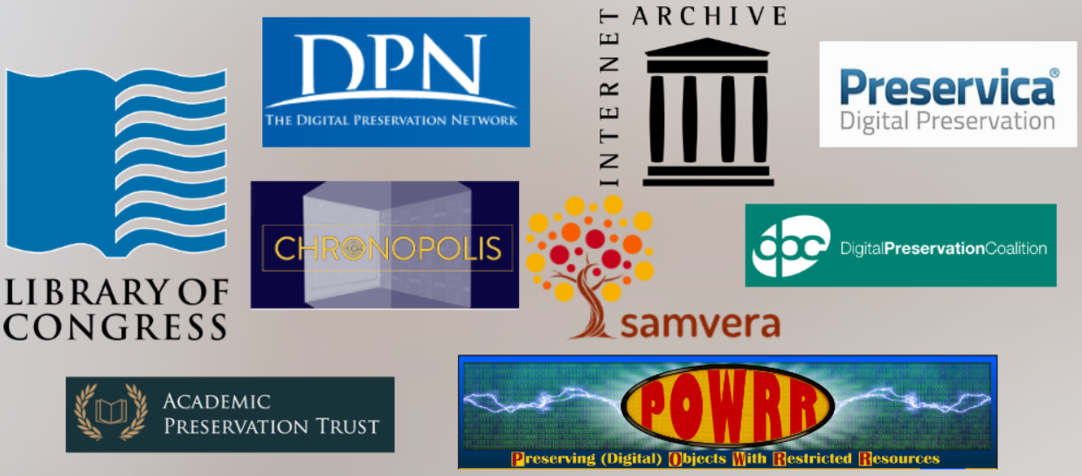
(Some) Organizations Addressing Digital Preservation Standards and Tools
Notes:
What else can you do? I won’t talk too much about this in this presentation but create metadata. Embed your datasets with preservation metadata (see PREMIS for a guide), version control your research, provide as much context to your work as possible. Data without context or provenance is as decipherable as the Etruscan language. There are many organizations that are currently working to solve the problems presented by digital preservation who have developed standards and tools. I highly recommend looking at the Digital Preservation Coalition’s Handbook, the Digital Preservation Tool Spreadsheet developed by POWRR, and the National Digital Stewardship Alliance’s levels of preservation.

Slide 7
Links to GitHub Sites
Rendered site:
http://geokels.github.io/dig-preservation/
Source code:
https://github.com/geokels/dig-preservation

